Slide 1
CSCI 558L Lecture 5: Transport Layer
Internetworking and Distributed Systems Laboratory
Young Cho
Department of Computer Science
University of Southern California
Slides adopted Computer Networking: A Top Down Approach 5th edition. Jim Kurose

Slide 2
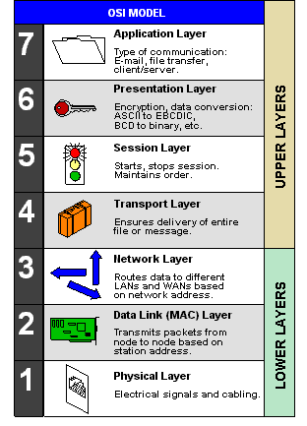
Open System Interconnection Reference Model
From computer desktop encyclopedia © 2004

Slide 3
Upper Layers Networking
Transport Layer
The delivery of data to the application
Reliable delivery
Error detection
Flow control
Congestion avoidance
TCP - Transmission Control Protocol
UDP - User Datagram Protocol
Session Layer
Opening, closing and managing a session
NetBIOS - Network Basic Input Output System
PPTP - Point-to-Point Tunneling Protocol
RPC - Remote Procedure Call Protocol
SCP - Secured Copy Protocol
Often pushed back to application
Presentation Layer
The delivery and formatting of information
Extended Binary Coded Decimal Interchange Code text file to an ASCII conversion
Encryption
Compression
Often pushed back to application
Application Layer
Custom applications
FTP - File Tranfer Protocol
HTTP - HyperText Transfer Protocol
SMTP - Simple Mail Transfer Protocol
POP3 - Post Office Protocol version 3
TELNET - Terminal Emulation Protocol of TCP/IP
SSH - Secure Shell
Your own protocols

Slide 4

Transport services and protocols
Provide logical communication between app processes running on different hosts
Run in end systems
send side: breaks app messages into segments, passes to network layer
rcv side: reassembles segments into messages, passes to app layer
More than one transport protocol available to apps
Internet: TCP and UDP
application
transport
network
data link
physical
logical end-end transport
application
transport
network
data link
physical

Slide 5
Transport vs. Network layer
Network layer: logical communication between hosts
Transport layer: logical communication between processes
relies on, enhances, network layer services
Postal service analogy:
kids sending letters to other kids
processes = kids
app messages = letters in envelopes
hosts = houses
transport protocol = two specific kids
network-layer protocol = postal service

Slide 6
Internet transport-layer protocols
Reliable, in-order delivery (TCP)
congestion control
flow control
connection setup
Unreliable, unordered delivery: UDP
no-frills extension of “best-effort” IP
Services not available:
delay guarantees
bandwidth guarantees
application
transport
network
data link
physical
network
data link
physical
network
data link
physical
network
data link
physical
logical end-end transport
network
data link
physical
network
data link
physical
network
data link
physical
application
transport
network
data link
physical

Slide 7
Multiplexing/Demultiplexing
Demultiplexing at rcv host:
Multiplexing at send host:
delivering received segments
to correct socket
gathering data from multiple
sockets, enveloping data with
header (later used for
demultiplexing)
= socket
= process
application
application
application
P4
P3
P1
P2
P1
transport
transport
transport
network
network
network
link
link
link
physical
physical
physical
host 1
host 2
host 3

Slide 8
Demultiplexing
Host receives IP datagrams
source IP address, destination IP address
datagram carries 1 transport-layer segment
source, destination port number
host uses IP addresses & port numbers to direct segment to appropriate socket
Connectionless demultiplexing
SP/DP forms 2-tuple Socket
SP provides return address
Used with UDP
Connection-oriented demultiplexing
SIP/DIP/SP/DP forms 4-tuple Socket
SIP/SP provides return address
32 bits
source port #
dest port #
other header fields
application data
(message)
TCP/UDP segment format

Slide 9
UDP: User Datagram Protocol [RFC 768]
“no frills,” “bare bones” Internet transport protocol
“best effort” service, UDP segments may be:
lost
delivered out of order to app
connectionless:
no handshaking between UDP sender, receiver
each UDP segment handled independently of others
Why is there a UDP?
no connection establishment (which can add delay)
simple: no connection state at sender, receiver
small segment header
no congestion control: UDP can blast away as fast as desired

Slide 10
UDP: more
often used for streaming multimedia apps
loss tolerant
rate sensitive
other UDP uses
DNS
SNMP
reliable transfer over UDP: add reliability at application layer
application-specific error recovery!
32 bits
Length, in
bytes of UDP
segment,
including
header
source port #
dest port #
length
checksum
Application
data
(message)
UDP segment format

Slide 11
TCP: Overview RFCs: 793, 1122, 1323, 2018, 2581
full duplex data:
bi-directional data flow in same connection
MSS: maximum segment size
connection-oriented:
handshaking (exchange of control msgs) init’s sender, receiver state before data exchange
flow controlled:
sender will not overwhelm receiver
point-to-point:
one sender, one receiver
reliable, in-order byte steam:
no “message boundaries”
pipelined:
TCP congestion and flow control set window size
send & receive buffers

Slide 12
TCP segment structure
32 bits
URG: urgent data
(generally not used)
counting
by bytes
of data
(not segments!)
source port #
dest port #
sequence number
ACK: ACK #
valid
acknowledgement number
head
len
not
used
U
Receive window
A
P
R
PSH: push data now
(generally not used)
S
F
# bytes
rcvr willing
to accept
checksum
Urg data pnter
RST, SYN, FIN:
connection estab
(setup, teardown
commands)
Options (variable length)
application
data
(variable length)
Internet
checksum
(as in UDP)

Slide 13
TCP seq. #’s and ACKs
Seq. #’s:
byte stream “number” of first byte in segment’s data
ACKs:
seq # of next byte expected from other side
cumulative ACK
Q: how receiver handles out-of-order segments
A: TCP spec doesn’t say, - up to implementor
Host A
Host B
User
types
‘C’
Seq=42, ACK=79, data = ‘C’
host ACKs
receipt of
‘C’, echoes
back ‘C’
Seq=79, ACK=43, data = ‘C’
host ACKs
receipt
of echoed
‘C’
Seq=43, ACK=80
time
simple telnet scenario

Slide 14
TCP Round Trip Time and Timeout
Q: how to set TCP timeout value?
longer than RTT
but RTT varies
too short: premature timeout
unnecessary retransmissions
too long: slow reaction to segment loss
Q: how to estimate RTT?
SampleRTT: measured time from segment transmission until ACK receipt
ignore retransmissions
SampleRTT will vary, want estimated RTT “smoother”
average several recent measurements, not just current SampleRTT

Slide 15
TCP Round Trip Time
EstimatedRTT = (1- α)*EstimatedRTT + α*SampleRTT
Exponential weighted moving average
influence of past sample decreases exponentially fast
typical value: α = 0.125

Slide 16
TCP Timeout
Setting the timeout
EstimtedRTT plus “safety margin”
large variation in EstimatedRTT -> larger safety margin
first estimate of how much SampleRTT deviates from EstimatedRTT:
DevRTT = (1-β)*DevRTT +
β*|SampleRTT-EstimatedRTT|
(typically, β = 0.25)
Then set timeout interval:
TimeoutInterval = EstimatedRTT + 4*DevRTT

Slide 17
TCP reliable data transfer
On top of IP’s unreliable Service
Pipelined segments
Cumulative Acks
Key to Reliable Delivery: Retransmission
TCP uses single retransmission timer
timeout events
duplicate acks

Slide 18
TCP: retransmission scenarios
Host A
Host B
Host A
Host B
Seq=92, 8 bytes data
Seq=92, 8 bytes data
Seq=100, 20 bytes data
timeout
ACK=100
Seq=92 timeout
X
ACK=100
loss
ACK=120
Seq=92, 8 bytes data
Sendbase
= 100
Seq=92, 8 bytes data
SendBase
= 120
Seq=92 timeout
ACK=120
ACK=100
SendBase
= 100
SendBase
= 120
premature timeout
time
time
lost ACK scenario

Slide 19
TCP retransmission scenarios
Host A
Host B
Seq=92, 8 bytes data
ACK=100
timeout
Seq=100, 20 bytes data
X
loss
SendBase
= 120
ACK=120
time
Cumulative ACK scenario

Slide 20
Fast Retransmit
Time-out period often relatively long:
long delay before resending lost packet
Detect lost segments via duplicate ACKs.
Sender often sends many segments back-to-back
If segment is lost, there will likely be many duplicate ACKs.
If sender receives 3 ACKs for the same data, it supposes that segment after ACKed data was lost:
fast retransmit: resend segment before timer expires

Slide 21
Fast Retransmit
Host A
Host B
X
timeout
resend 2nd segment
time

Slide 22
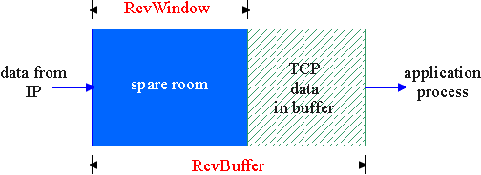
TCP Flow Control
flow control
receive side of TCP connection has a receive buffer:
sender won’t overflow
receiver’s buffer by
transmitting too much,
too fast
speed-matching service: matching the send rate to the receiving app’s drain rate

Slide 23
TCP Flow control
(Suppose TCP receiver discards out-of-order segments)
spare room in buffer
= RcvWindow
= RcvBuffer-[LastByteRcvd - LastByteRead]
Rcvr advertises spare room by including value of RcvWindow in segments
Sender limits unACKed data to RcvWindow
guarantees receive buffer doesn’t overflow

Slide 24
Congestion
Sending too much data too fast
different from flow control
Lost packets
buffer overflow at routers
Long delays
queueing in router buffers

Slide 25
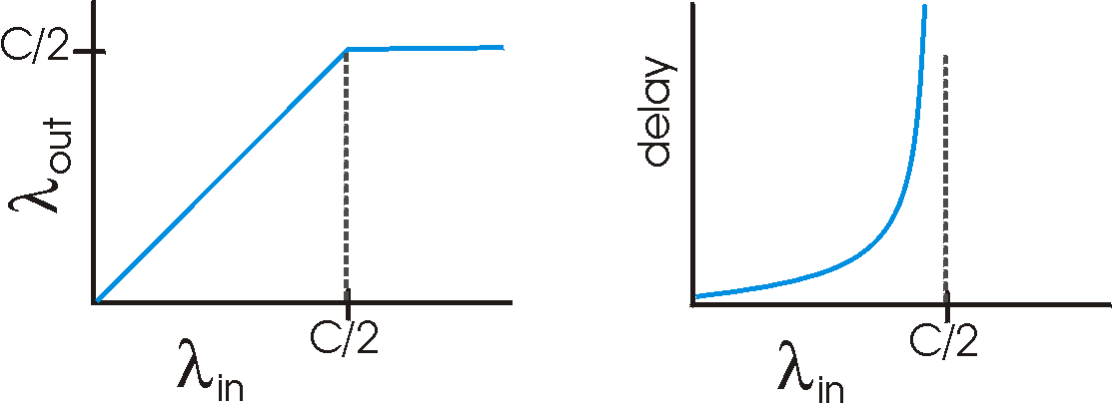
Causes/costs of congestion: scenario 1
two senders, two receivers
one router, infinite buffers
no retransmission
Host A
λ_{in} : original data
λ_{out}
Host B
unlimited shared output link buffers
large delays when congested
maximum achievable throughput

Slide 26
Causes/costs of congestion: scenario 2
one router, finite buffers
sender retransmission of lost packet
Host A
λ_{in} : original data
λ_{out}
λ'_{in} : original data, plus retransmitted data
Host B
finite shared output link buffers

Slide 27
Two broad approaches towards congestion control
End-end congestion control:
no explicit feedback from network
congestion inferred from end-system observed loss, delay
Approach taken by TCP
Network-assisted congestion control:
routers provide feedback to end systems
single bit indicating congestion (SNA, DECbit, TCP/IP ECN, ATM)
explicit rate sender should send at

Slide 28
TCP congestion control
Approach: increase transmission rate (congestion window size), probing for usable bandwidth, until loss occurs
additive increase: increase CongWin by 1 MSS every RTT until loss detected
multiplicative decrease: cut CongWin in half after loss
congestion window size
Saw tooth
behavior: probing
for bandwidth

Slide 29
TCP Congestion Control
Sender limits transmission
Roughly,
CongWin is dynamic
function of perceived network congestion
Three mechanisms
Additive Increase Multiplicative Decrease
Slow start
Conservative after timeout events
rate =
CongWin
Bytes/sec
RTT

Slide 30
TCP Slow Start
When connection begins
CongWin = 1 MSS (Maximum Segment Size)
Example: MSS = 500 bytes & RTT = 200 msec
initial rate = 20 kbps
Available bandwidth may be >> MSS/RTT
desirable to quickly ramp up to respectable rate
When connection begins
increase rate exponentially fast until first loss
increase rate exponentially until first loss event:
double CongWin every RTT
done by incrementing CongWin for every ACK received
Host A
Host B
one segment
RTT
two segments
four segments
time

Slide 31
Refinement: inferring loss
After 3 dup ACKs:
CongWin is cut in half
window then grows linearly
indicates network capable of delivering some segments
But after timeout event:
CongWin instead set to 1 MSS
window then grows exponentially
to a threshold, then grows linearly
indicates a “more alarming” congestion scenario

Slide 32
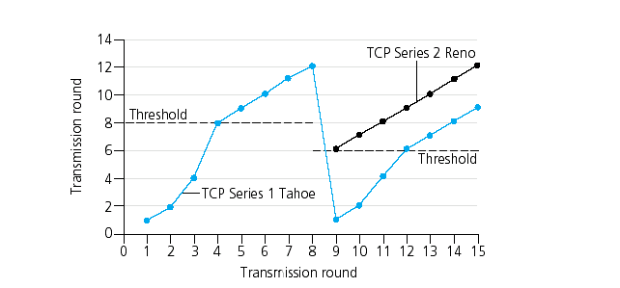
Refinement
When should the exponential increase switch to linear?
CongWin gets to 1/2 of its value before timeout.
Implementation:
Variable Threshold
At loss event, set Threshold to 1/2 of CongWin before loss

Slide 33
TCP Congestion Control Summary
When CongWin is below Threshold, sender in slow-start phase, window grows exponentially.
When CongWin is above Threshold, sender is in congestion-avoidance phase, window grows linearly.
When a triple duplicate ACK occurs, Threshold set to CongWin/2 and CongWin set to Threshold.
When timeout occurs, Threshold set to CongWin/2 and CongWin is set to 1 MSS.

Slide 34
TCP sender congestion control
State | Event | TCP Sender Action | Commentary
Slow Start (SS) | ACK receipt for previously unacked data | CongWin = CongWin + MSS, If (CongWin > Threshold) set state to “Congestion Avoidance” | Resulting in a doubling of CongWin every RTT
Congestion Avoidance (CA) | ACK receipt for previously unacked data | CongWin = CongWin+MSS * (MSS/CongWin) | Additive increase, resulting in increase of CongWin by 1 MSS every RTT
SS or CA | Loss event detected by triple duplicate ACK | Threshold = CongWin/2, CongWin = Threshold, Set state to “Congestion Avoidance” | Fast recovery, implementing multiplicative decrease. CongWin will not drop below 1 MSS.
SS or CA | Timeout | Threshold = CongWin/2, CongWin = 1 MSS, Set state to “Slow Start” | Enter slow start
SS or CA | Duplicate ACK | Increment duplicate ACK count for segment being acked | CongWin and Threshold not changed

Slide 35
TCP Fairness
Fairness goal: if K TCP sessions share same bottleneck link of bandwidth R, each should have average rate of R/K
Additive increase gives slope of 1, as throughout increases
multiplicative decrease decreases throughput proportionally
TCP connection 1
TCP
connection 2
bottleneck
router
capacity R

Slide 36
Next
Next Lecture: Routing in Internet
Laboratory 4: Fast and Reliable FTP
Part A – Due Sept 15th, demo 17th
Part B – Demo Sept 24th ,Finalists Compete 25th
Reading Assignment
Gerla, M. et al, "Generalized Window Advertising for TCP Congestion Control", UCLA Tech Report, Feb 1999.
Due September 15 at 11:55pm

